Slide 1

Installation of Salt on Windows
Welcome to this presentation on installing Salt on Windows. Salt is a powerful automation and configuration management software that enables faster and more accurate IT operations. Let's get started!
ek
by Charanjit Singh

Slide 2

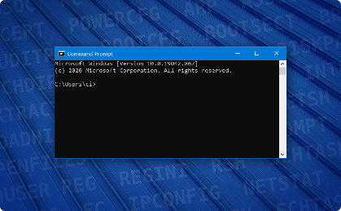
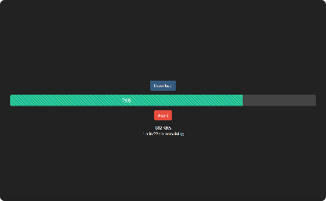

Downloading Salt on Windows
Download the Latest Salt Version
Open the Command Prompt
Installation Progress
Successful Installation
Go to the Salt website and download the latest version of Salt for Windows.
Open the Command Prompt as an administrator to install Salt on Windows.
Watch as the installation proceeds and keep an eye on the progress bar.
Once the installation is finished, you should see a message that Salt has been successfully installed on your Windows machine.

Slide 3
Installation Prerequisites
Python 3
Windows Firewall
Configuration Files
Salt requires Python 3 to be installed. Make sure it's installed on your Windows machine before proceeding with the installation.
Ensure that the Windows Firewall is not blocking Salt from running. You may need to add Salt as an exception to your firewall rules.
Before you can use Salt, you'll need to configure the Salt master and minion. Make sure you have the necessary configuration files before getting started.

Slide 4
Installing Salt on Windows
Installer Progress
Watch as the installation progresses. This may take a few minutes, depending on the speed of your machine.
1
2
3
Command Prompt
Installation Complete
Use the Command Prompt to install Salt on Windows machine. Run the command "python -m salt- installer -P -c c:\salt" to install Salt and the necessary dependencies.
After installation is complete, you'll see a message indicating that it was successful.

Slide 5
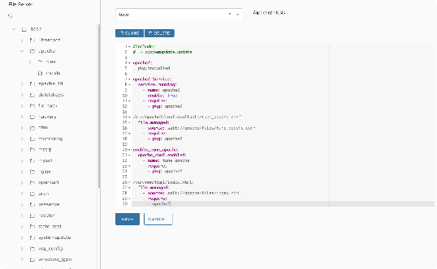
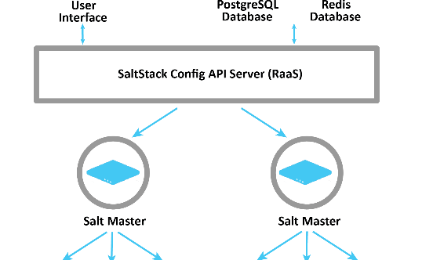

Configuring Salt Master and Minion
The Configuration Files
Instructions to Follow
Getting Started with Salt
The Salt master and minion must be properly configured to work together. Be sure to check and modify the configuration files as needed.
Make sure you follow the instructions on the Salt website carefully to configure the master and minion correctly.
To get started with Salt, you can use basic commands, such as "salt '*' test.ping" to check connectivity between the Salt master and minion.

Slide 6


Testing Salt Installation
1
Test Your Salt Installation
2
Commands to Use
You can use a variety of commands to ensure that Salt is working and communicating with the master properly. Try "salt '*' test.ping" or "salt '*' cmd.run 'ipconfig /all'".
Use basic commands to test whether Salt is properly installed on your machine.
3
Successful Result
If you see a successful result from the command, then Salt is properly installed and configured on your machine.

Slide 7
Conclusion and Next Steps
Benefits of Salt
Next Steps
Salt enables IT organizations to automate and manage complex infrastructure at scale, saving time and reducing errors.
Explore the Salt documentation and start creating custom modules and states;
Join the Salt community and attend online or in-person events to learn more;
Try SaltStack Enterprise and expand your capabilities.

Slide 8

Questions and Discussion
Thank you for your attention. Do you have any questions or feedback?

